Slide 1
Nhat Doan CSC131 MAX 737 software engineering

Slide 2
Max 373 uses the system call MASS which is really cheaper than extensively modifying the airframe
The problem of insisting that 737 Max has no difference in flying characteristics, no difference in system.
The sensors within the systems did not get to test clearly which lead to malfunction of the system; specially the envelope protection
The false report triggered an automated system known as the Maneuvering Characteristics Augmentation System, or MCAS
https://spectrum.ieee.org/aerospace/aviation/how-the-boeing-737-max-disaster-looks-to-a-software-developer

Slide 3
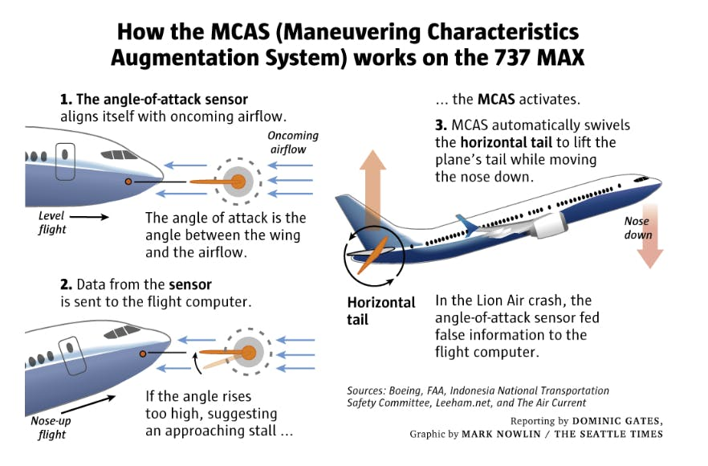
https://moneymaven.io/mishtalk/economics/boeing-737-max-major-design-flaws-not-a-software-failure-rVjJZBVzZkuZLkDJn3Jy8A/

Slide 4
By Gregory Travis
“Those lines of code were no doubt created by people at the direction of managers. Neither such coders nor their managers are as in touch with the particular culture and mores of the aviation world as much as the people who are down on the factory floor, riveting wings on, designing control yokes, and fitting landing gears. Those people have decades of institutional memory about what has worked in the past and what has not worked. Software people do not.”

